Slide 1

Name: DISHEN MAKWANA
Enrollment No: 180470107035
Semester: 8th
AtliQ technologies

Slide 2
AtliQ
Founded in 2017.
Leading IT companies provide a range of services including Software Development, Web & App development, Data Analytics, Digital Marketing, and Branding to name a few.
Our enthusiastic team of experts in technology, branding, and operations is the best choice for your business growth through automation and technology.
Our working philosophy enables us to maintain an ethical culture, which adds value not only to us but also to our clients.
Everyone in our team takes up the responsibility and is accountable for every move, which allows them to build themselves as a leader.

Slide 3


Services company offers
- Enterprise Application Development
- Software Development
- Mobile Application Development
- RPA Development
- Business Strategy Consulting
- Digital Marketing
- Product Development

Slide 4
My Role At Company
I joined AtliQ on 3rd January 2022 as Software development engineer Intern for program of 6 month of internship at Vadodara.
Honestly saying I am getting very good support from the whole staff and that will help me to give a sharp shape to my skills and knowledge as well.
I am not a professional developer, but I will so as of now involving me in a company project, but they are being give me mini projects or task that are designed for interns and trainers.

Slide 5
Practice for React & NodeJS
Todo-List
Learning React and Create basic CRUD.
Redux-toolkit for manage state and cache data.
Filters for Active/Completed/All todo-list.
Inline Edit Todos
Use Material Icons for beautify UI.
Link : https://dishen-todos.netlify.app
Code : https://github.com/DishenMakwana/ToDo-React-Redux

Slide 6
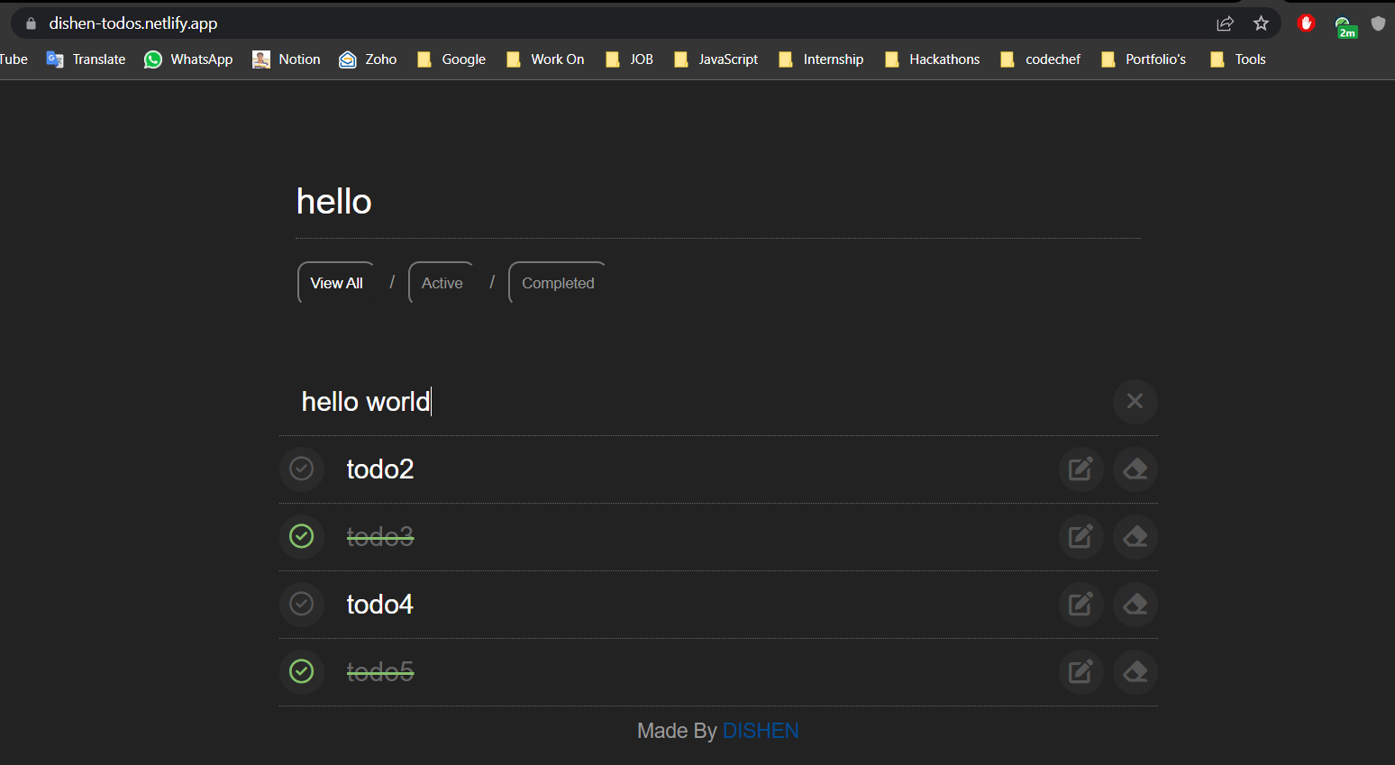

Slide 7
Practice for React & NodeJs
Real time chat app using MERN stack. It is one or one and group chat application.
Admin have access to invite new people in group and modify them.
Socket Io library to display real-time response.
JWT for authentication
Role based access for authorization.
UI created with react and state management use Redux.
BcryptJS for password encryption.
Toast for Notification.
Searching by username in group and global.
Link : https://chat-time-mern.herokuapp.com
Code : https://github.com/DishenMakwana/Chat-Time

Slide 8
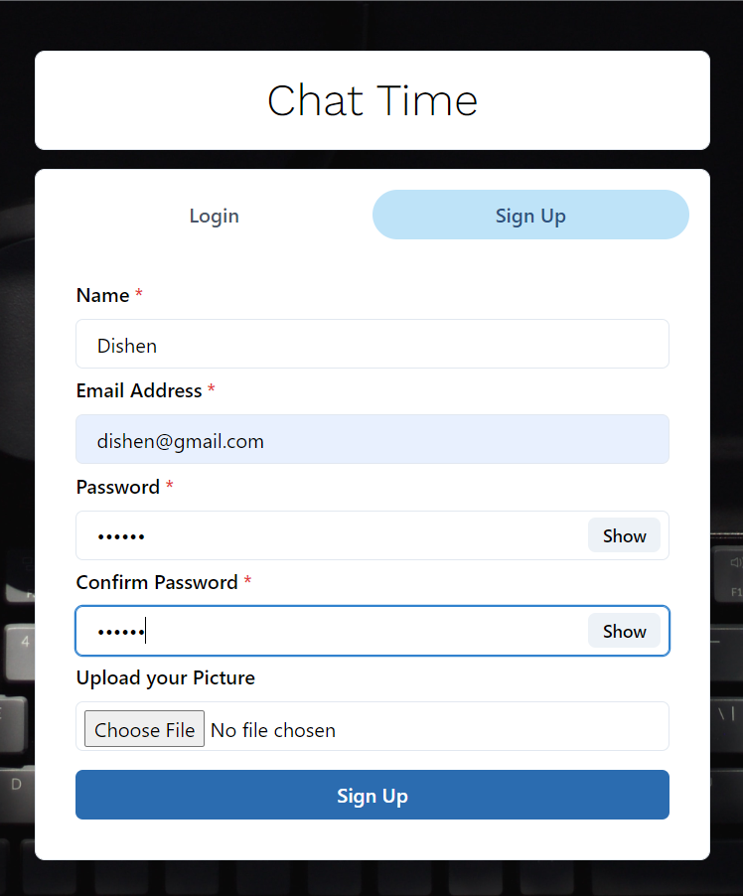
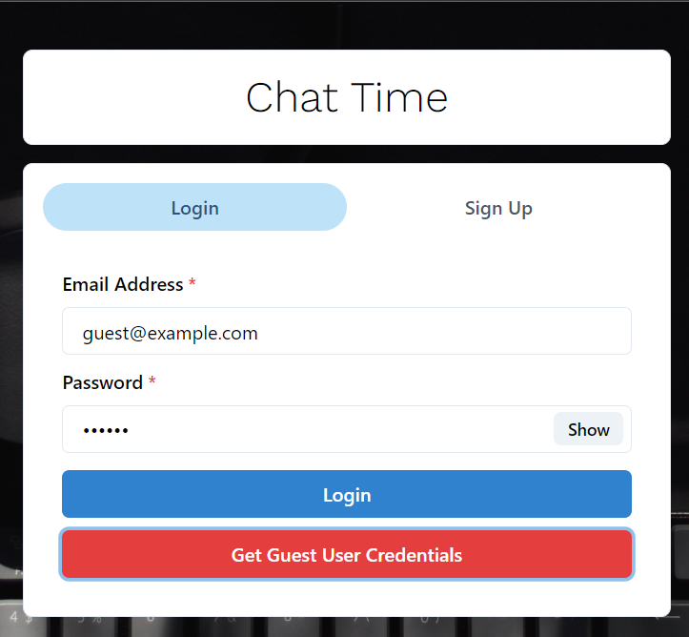

Slide 9
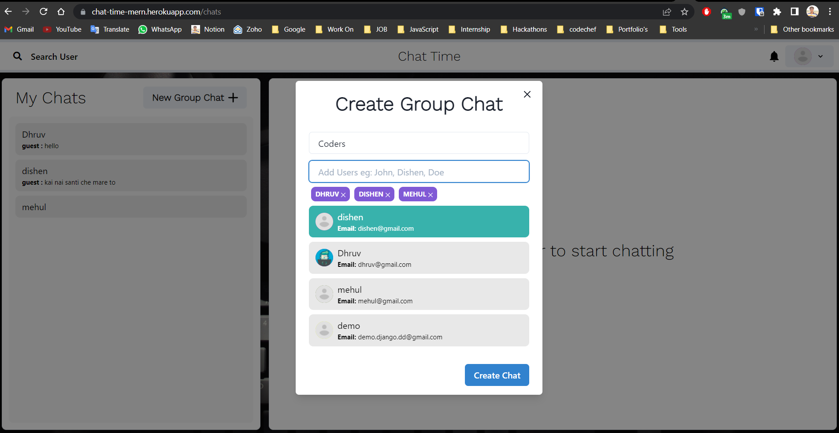

Slide 10
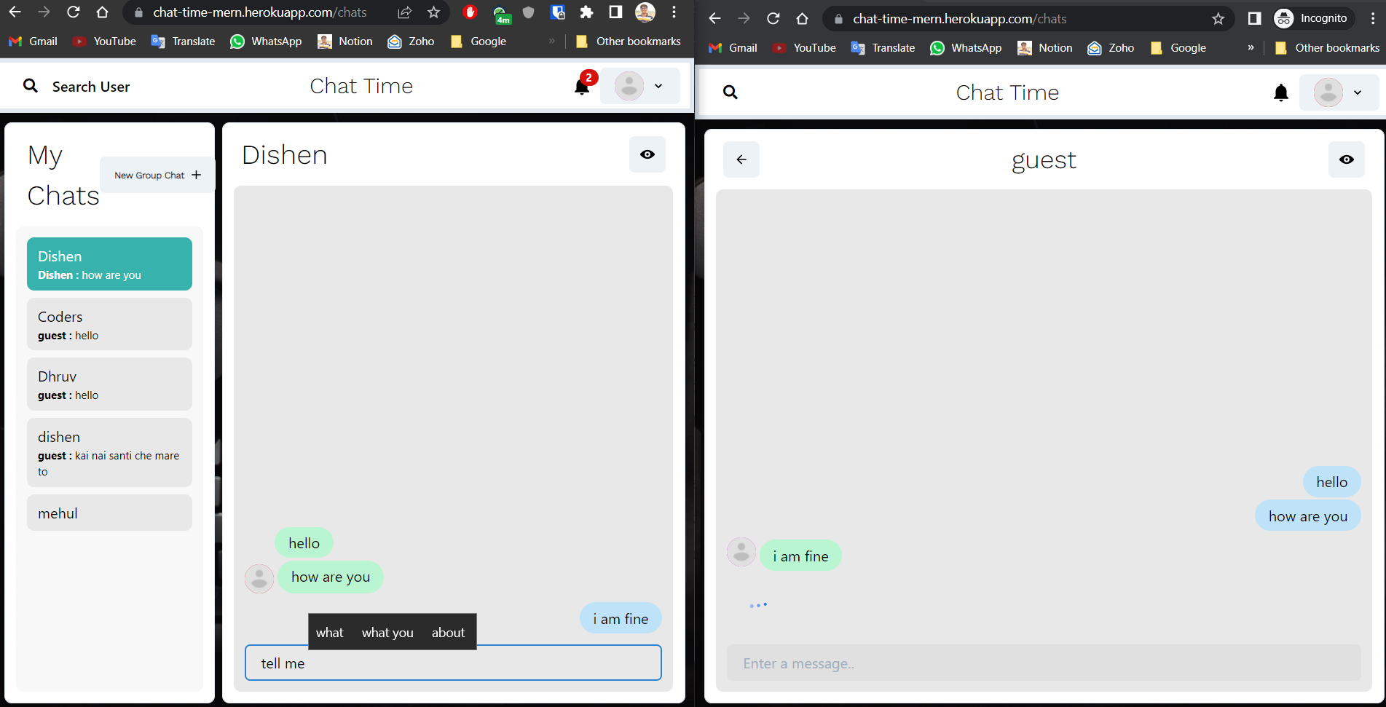

Slide 11
Task Management Tool
The most important feature in today’s modern day is about time management.
Tool helps organizing projects and their sprints in proper manner.
The tool has covered all the aspects that an IT firm requires for increasing productivity.
User Friendly UI.
Remove redundant work.
This tool manager can know that status of all sprints and their task by just checking the board given.
Developer just needs to log the time spent for a particular task here.
Automated entry is made in companies' personal software where all this log is maintained.

Slide 12
Task Management Tool
Reference from tool JIRA.
Tool wants some the feature of JIRA.
This platform is developed for time productivity and automated entry into companies' other portal.
The expected outcome is to create a platform that satisfies the companies need, increase productivity and automation.
This will also decrease the usage of multiple platforms by developers such as Kaizen, GitLab.
Capture all the details of task and will automatically log the time spent on the task
So, time is saved & redundancy is reduced.
Tools & Technologies
React for Frontend & Redux for state management.
Hooks for rendering updated states.
Backend with NodeJs, Expressjs with MySql connect with SequelizeORM.

Slide 13
Scope of work
Team Management
Team task assign
Sprints CRUD
Sprint Board
TMT Features
Add Project – onboarding new project
Sprints Module
- Lead have all access.
Tasks Module
- Lead can create Tasks sprint-wise.
- Lead can assign Tasks to members.
- Members can use board to move tasks.
Approach
I have tried to follow fat controller and thin model (MVC) approach for better understanding of code. Agile methodology for software development.
Challenges
Challenges was faced in development of Kanban module for API as well as WEB. In Permission based access of modules.

Slide 14
My Contribution
Working on an in-production system was a great opportunity for me. Here are the contribution from my end to the system.
Backend
Database Design
API with CRUD operation
File upload using Multer for form-data input
Added documentation and test cases across the system
Permission based access
Connect Mysql database with Sequelize ORM and create table with migration.
Added data in table using seeders.
Frontend
Added state management using React Redux.
Added permission-based access on routes.
Create one listing page of sprints based on login user.

Slide 15
Task Management Tool
Future Work
Will connect all the views via API and make entire project dynamic
Need to do R&D for the automated entry to the kaizen platform
Perform CRUD for all the views once APIs are created properly.
Connect GitLab with this app to manage connected apps easily with one login
Perform automation task to assign issues to any user.
Real time progress of product development.
Connect Gitlab-Kiazen-TMT-Slack to manage projects easily.
Kaizen is AtliQ’s in-house product which has website to digitize all organization level things.
Kaizen has project management, employee onboardings, Accounts, announcements , meetings, remarks to employee, easy-to-use piece of software.
Mainly kaizen can be useful for tracking companies progress in terms of money, projects outcome and employees eﬃciency.

Slide 16
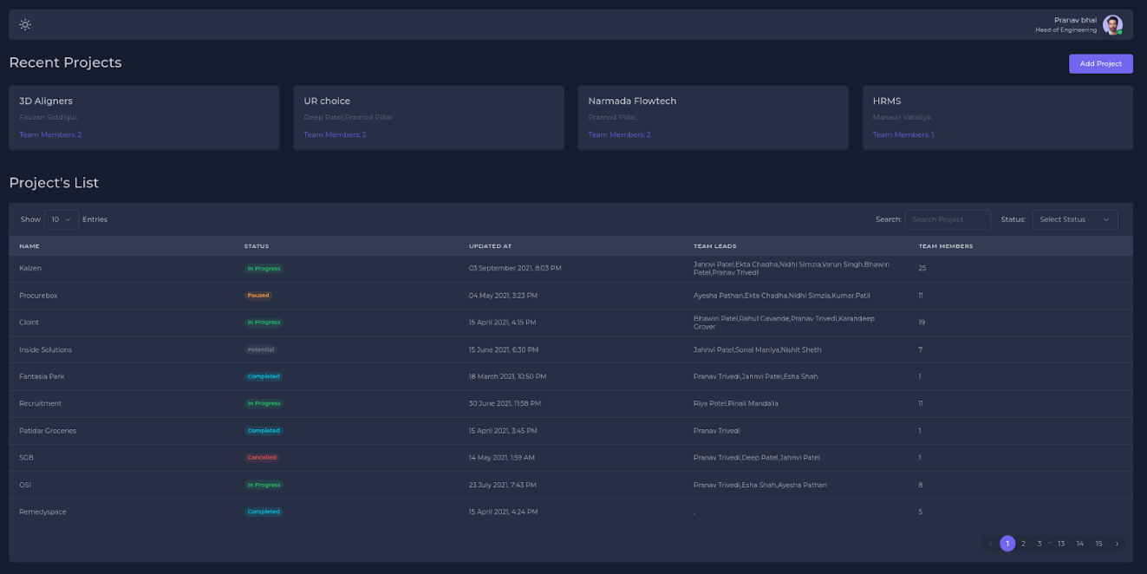

Slide 17
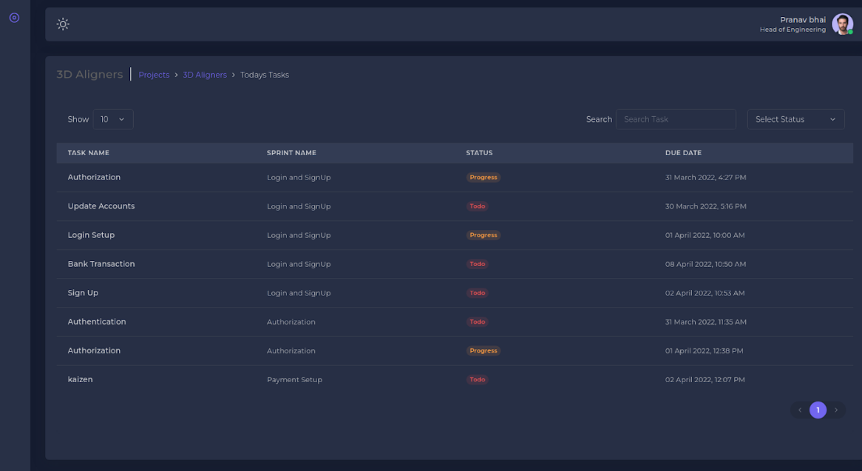

Slide 18
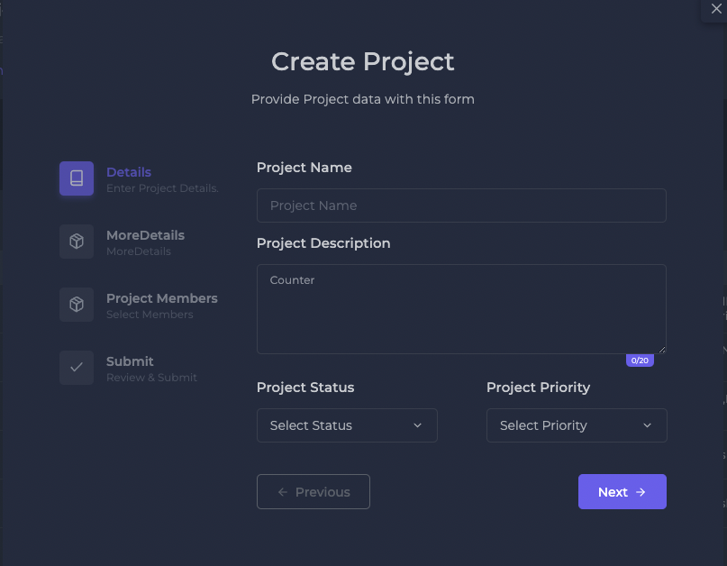
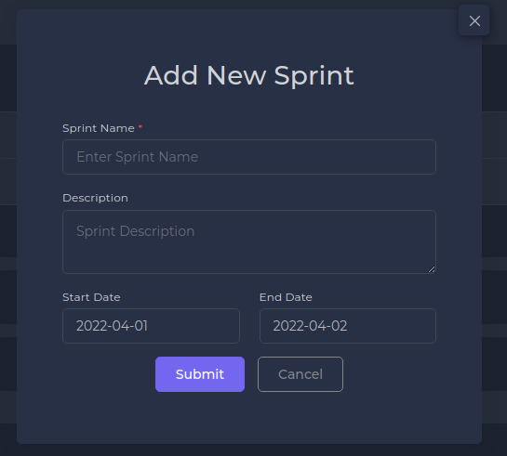

Slide 19
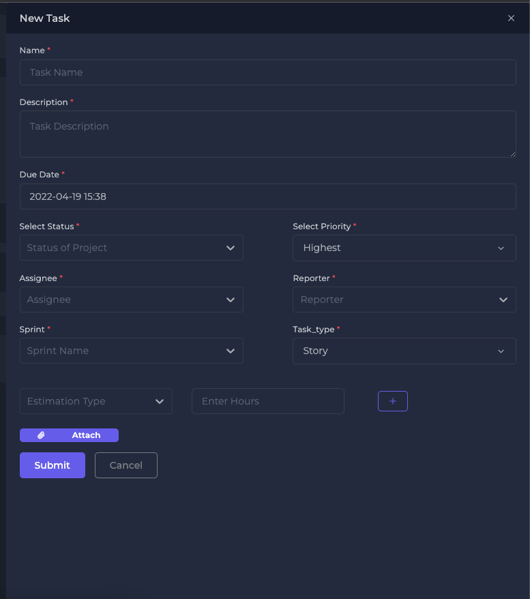
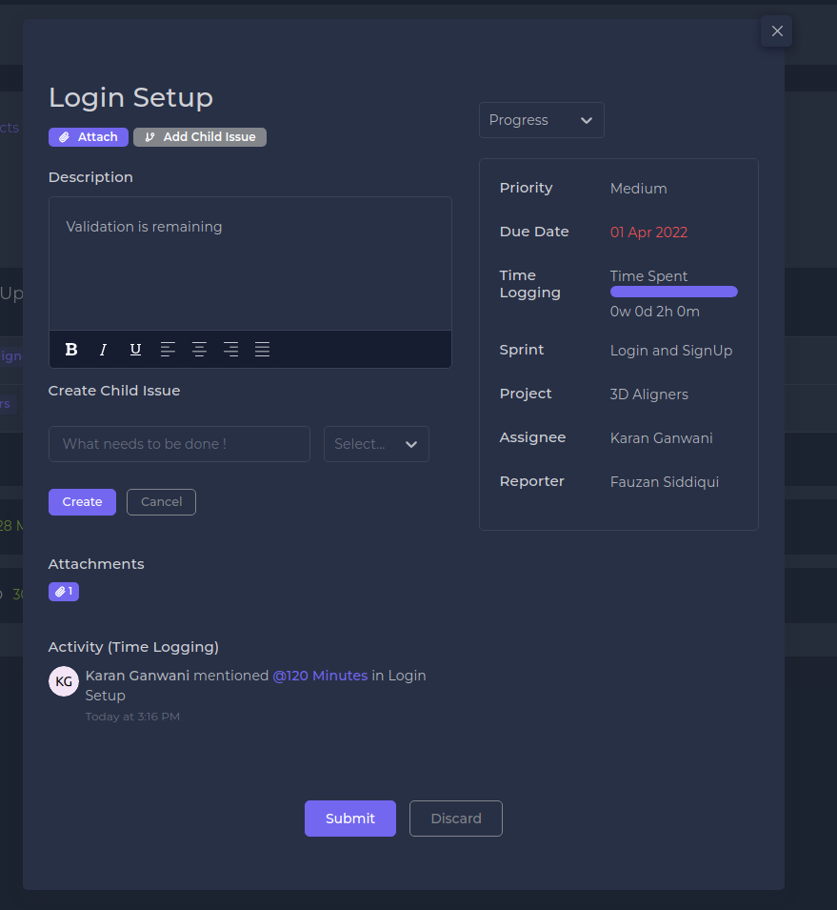

Slide 20
Quite Clear
Admin Portal
All details of orders and real-time data for revenue.
Order data as pie-chart view with monthly orders and real time total-orders, total users & total revenue.
Admin can add new brands/model, update & delete it also.
Store user wise pricing.
Admin can download all user's data and all orders data in Excel file.
SuperAdmin create sub-admin for diversify their work easily.
Role base permission based on module.
Change user payment method.
Admin can block user & sub-admin as well.
AWS SES integration for mail service.

Slide 21
Quite Clear
User Portal
Order models/aligners
Upload patient’s files at time of register and edit.
Change address for product delivery.
At time of patient entry, they upload obj/stl files.
Admin & Dentist download order invoices.
Razorpay integration for online payment.
Customer Base
Geographically:- Indian base.
Target Audience:- Doctors, Orthodontists, Dentists, B2C Aligner companies.
Medical Industries.
Link : https://admin.third-in-rev.infobizzs.net
https://doctor.third-in-rev.infobizzs.net

Slide 22
Thank you

